Slide 1


Team Analytic Strategists
Notes:
Our mission is to help our client increase productivity by reducing attrition rates through data-driven insights and actionable recommendations. We achieve this by analyzing different attributes provided by customer and find any inform strategies to improve employee retention. By collaborating closely with HR and other stakeholders, we aim to develop targeted interventions that address the root causes of attrition and help create a more engaged and motivated workforce. We are committed to delivering a solution that not only reduces attrition, but also drives long-term business success.

Slide 2
Topic | Slide #
INTRODUCTION | 3
END USER AND PROBLEM | 4
DATASET EXPLANATION | 8
DIFFERENT STEPS IN REACHING SOLUTIONS | 11
FINAL SOLUTION | 19
Notes:
Our mission is to help our client increase productivity by reducing attrition rates through data-driven insights and actionable recommendations. We achieve this by analyzing different attributes provided by customer and find any inform strategies to improve employee retention. By collaborating closely with HR and other stakeholders, we aim to develop targeted interventions that address the root causes of attrition and help create a more engaged and motivated workforce. We are committed to delivering a solution that not only reduces attrition, but also drives long-term business success.

Slide 3



INTRODUCTION
End User
Problem
Strategy to solve problem
Notes:
Our mission is to help our client increase productivity by reducing attrition rates through data-driven insights and actionable recommendations. We achieve this by analyzing different attributes provided by customer and find any inform strategies to improve employee retention. By collaborating closely with HR and other stakeholders, we aim to develop targeted interventions that address the root causes of attrition and help create a more engaged and motivated workforce. We are committed to delivering a solution that not only reduces attrition, but also drives long-term business success.

Slide 4

END USER AND PROBLEM
Customer: Northern Lights Ventures
Problem: Reduced profitability -Attrition
End. User: The Human Resource Manager, CFO.
Strategy : Hiring an analytics team
Notes:
Our mission is to help our client increase productivity by reducing attrition rates through data-driven insights and actionable recommendations. We achieve this by analyzing different attributes provided by customer and find any inform strategies to improve employee retention. By collaborating closely with HR and other stakeholders, we aim to develop targeted interventions that address the root causes of attrition and help create a more engaged and motivated workforce. We are committed to delivering a solution that not only reduces attrition, but also drives long-term business success.

Slide 5


INTRODUCING ANALYTIC STRATEGISTS
Team Members
Team Mission
Notes:
Our mission is to help our client increase productivity by reducing attrition rates through data-driven insights and actionable recommendations. We achieve this by analyzing different attributes provided by customer and find any inform strategies to improve employee retention. By collaborating closely with HR and other stakeholders, we aim to develop targeted interventions that address the root causes of attrition and help create a more engaged and motivated workforce. We are committed to delivering a solution that not only reduces attrition, but also drives long-term business success.

Slide 6

Team Members​
Name​​​ | Qualification​​​ | Experience​​​ | Contribution​​​
Abin Benny​​​ ​​​ | ​MSC in Quantitative Finance | ​​​NIL | ​​​Insight and Slide presentation
Akshay Kochuparambil​​​ Joseph​​​ | ​​​Btech. Computer Science | ​​​3.5 years' experience as software implementation engineer | ​​​Slide preparation and insight
Arun Joy (TL)​​​ | MBA in Project Management​​​ | 1 year as Project admin​​​ | Data Visualization​​​
Sabarinath Sheela Jayamohan ​​​ | MBA in Marketing and Operations​​​ | 2 years as Asst. Manager at ICICI Bank​​​ | Coding and Insight​​​
Shalu Jose​​​ | MCA​​​ | 7 years as business Administration​​​ | Logic and business understanding​​​
Vidhiben Patel Nitinbhai ​​​ | MSC IT​​​ | 3 years as developer​​​ | Essential concepts of Python Programming​​​
Notes:
Our mission is to help our client increase productivity by reducing attrition rates through data-driven insights and actionable recommendations. We achieve this by analyzing different attributes provided by customer and find any inform strategies to improve employee retention. By collaborating closely with HR and other stakeholders, we aim to develop targeted interventions that address the root causes of attrition and help create a more engaged and motivated workforce. We are committed to delivering a solution that not only reduces attrition, but also drives long-term business success.

Slide 7

Team Vision and Mission
Vision: To be a leading provider of data-driven insights that empower decision-making and drive business success.
Mission: Increase productivity by reducing attrition through data-driven insights and targeted interventions
Notes:
Our mission is to help our client increase productivity by reducing attrition rates through data-driven insights and actionable recommendations. We achieve this by analyzing different attributes provided by customer and find any inform strategies to improve employee retention. By collaborating closely with HR and other stakeholders, we aim to develop targeted interventions that address the root causes of attrition and help create a more engaged and motivated workforce. We are committed to delivering a solution that not only reduces attrition, but also drives long-term business success.

Slide 8


Categorized Employee Dataset
Personal Details
Satisfaction level
Job Details
Employee Number
Age
Gender
Education
Education Field
Marital Status
Distance from Home
Number of companies worked
Over18
Total Working Years
Years In Current Role
Years With Current Manager
Training Times Last Year
Years At Company
Years Since Last Promotion
Environment Satisfaction
Job Involvement
Job Satisfaction
Performance Rating
Relationship Satisfaction
Work Life Balance
Job Role
Job Level
Department
Business Travel
Years with Current Manager
Overtime
StandardHours
Notes:
BusinessTravel: This shows the travel pattern of the employees. The values of this field are Travel_Rarely, Travel_Frequently and Non-Travel
Distance From Home: This shows distance of the employee's home from the company and its value is numerical one.
Employee Number: This is the unique id number for the employees and the numerical value range is from 1 to 2068.
Environment Satisfaction: How satisfied the employee is with company environment
Job Level: This represents the job level of employees and its numerical value is from 1 to 5.
Job Role: This character field shows all the job roles in the company and its values are Sales Executive, Research Scientist, Laboratory Technician, Manufacturing Director, Healthcare Representative, Manager, Sales Representative, Research Director, Human Resources.
Job Satisfaction: How satisfied the employee is about his job
Monthly Income: How much is the income including the bonuses
Monthly Rate: Standard salary per month

Slide 9
Categorized Employee Dataset
Remuneration
Company Details
Hourly Rate
Daily Rate
Monthly Income
Percent Salary Hike
Stock Option Level
Monthly Rate
Attrition
Employee Count
Notes:
Num Companies Worked: It denotes the number of companies that each employees worked before and its value is always numerical.
Over 18: It shows whether the employees are above 18 or not and every employees have the value "Y" which shows its an yes.
Percent Salary Hike: This salary hike received by each employees and it value is always numerical.
Performance Rating: Which level is employee's performance.
Stock Option Level: How much percentage of stock each person is allowed to buy at special price
Total Working Years: This field stands for the total working years of each employee in the company and its value is numerical.
Training Times Last Year: How many times they have attended training

Slide 10

Steps in finding the Insight
Python platform was selected to analyze the dataset and data was imported using pandas' and seaborn package.
Cleaning the dataset
Stage 1 Analysis: Reducing the dataset for the second level of analysis based on the relevancy with the attrition rate
Step 2 Analysis: Analyzing multiple attributes together results in identifying the attribute which mostly affect the attrition
Notes:
Data provided by the company was clean
using 'isnull()' function it was clear that there were no null values present in the data
Using Unique function team could easily identify that there was no issues related to case sensitive data

Slide 11
Steps in finding the Insight
Analysis, which is explained detail in next slide
From the analysis, we get the insights regarding the attrition rate
We need to interpret the solution from the insights
Notes:
Data provided by the company was clean
using 'isnull()' function it was clear that there were no null values present in the data
Using Unique function team could easily identify that there was no issues related to case sensitive data

Slide 12


Data Analysis using Python
Notes:
Here we use Python for Data Analysis due to following factors:
Ease of use: Pythons simple and consistent syntax make it user friendly to beginners while still captivating experienced programmers.
Python boasts exceptional libraries including the likes of NumPy, Pandas and Matplotlib that provide efficient and flexible data manipulation.

Slide 13

Data Cleaning Sample Codes
The following python query was utilized for the purpose of cleaning the data:
data=data.dropna(how='all', axis = 0) data=data.dropna(how='all', axis = 1) data=data.replace(' ',None) data.columns=data.columns.str.strip()
data=pd.read_excel('WA_Fn-UseC_-HR-Employee-Attrition.xlsx')
Notes:
data=data.dropna(how='all', axis = 0): This line removes all rows from the Data Frame that have Null values for all of their values.
data=data.dropna(how='all', axis = 1): This line removes all columns from the Data Frame that have Null values for all of their values.
data=data.replace(' ',None): This line changes every instance of the space character in the Data Frame to a None value.
data.columns=data.columns.str.strip(): This line cleans up the column names in the Data Frame by removing any leading or following whitespace.

Slide 14

First Stage Analysis
Each Attributes in Data was analyzed against Attrition
Result: The attributes set was decreased tremendously to have second level Analysis
Notes:
Using Pandas package Loc & Boolean function we have analyzed each column against Attrition . In some case if the data range was numbers we have considered different intervals or range
Results are as below: .Decreased dataset to 13 attributes. Which are 'AgeInterval1', 'Department', 'DistanceFromHomeInterval1', 'Education', 'JobLevel', 'MonthlyIncomeRange1', 'NumCompaniesWorked', 'PerformanceRating1', 'StockOptionLevel', 'TotalWorkingYears1', 'YearsAtCompany1', 'YearsSinceLastPromotion', 'YearsWithCurrManager1']

Slide 15

General Query
#Attrition against business traveling type count=data.loc[data['Attrition'] == 'Yes','BusinessTravel'].value_counts()
#Attrition against gender count=data.loc[data['Attrition'] == 'Yes','Gender'].value_counts() count
Notes:
For the first step analysis, we use the loc function for checking the relationship between attrition rate and all other attributes.
We use the pandas package as well as the numpy package for the analysis.
count=data.loc[data['Attrition'] == 'Yes','BusinessTravel'].value_counts(): This line calculates the total number of departing workers for the "BusinessTravel" category. It then uses the value_counts() function on the "Business Travel" column to select just the rows where "Attrition" is 'Yes' and calculates the number of workers in each category.
count=data.loc[data['Attrition'] == 'Yes','Gender'].value_counts(): The identical function is performed here, but using the "Gender" category.

Slide 16
Second Stage Analysis
In this stage combination of different attributes selected from first level analysis were considered for Analysis
Result 1: The main reason for Attrition was analyzed low salary and low stock option level
Result The Higher level of attrition was seen in Bachelors Probably because they are opting for higher degree
Notes:
Combination of attributes were used to analyze the importance of one attribute over another against attrition.

Slide 17
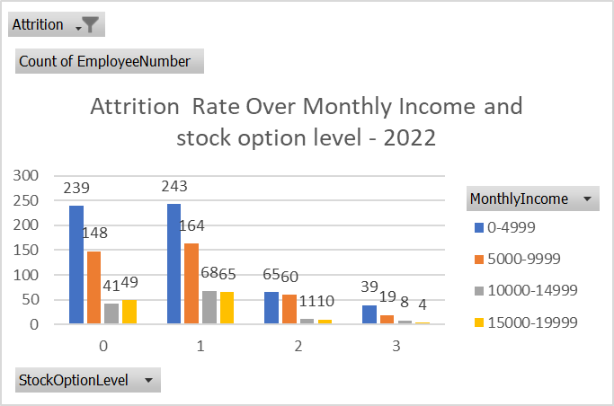
Visual Representation of Attrition Rate
Notes:
The slide shows the attrition rate over monthly income and stock option level in 2022.

Slide 18
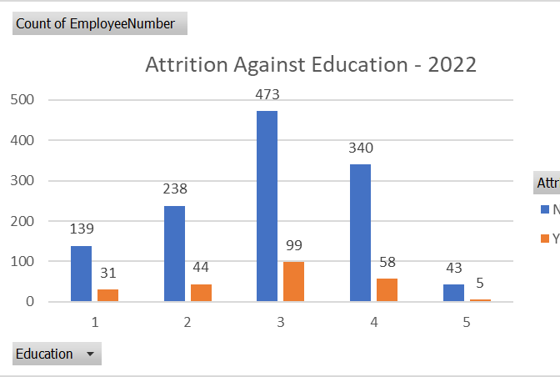
Visual Representation of Attrition Rate Attrition Against Education Blue-Yes Orange-No
Notes:
The slide shows the attrition rate against education in year 2022.

Slide 19

Solution
Conduct a compensation analysis to identify gaps in the current package.​
Increase salary and stock options to attract and retain top talent. ​
Provide scholarship opportunities for top-performing staff to study parallelly, which can not only enhance their skills but also demonstrate the organization's commitment to their career development and growth.
Notes:
No particular information available to be added in the notes

Slide 20
Summary
Northern Lights Ventures faced reduced profitability due to high attrition rates among employees
An analytics team was hired to provide data-driven insights and targeted interventions to address the problem
The team conducted a two-stage analysis of the data, which revealed low salary and low stock option levels as the main reasons for attrition
Employees with Bachelor's degrees had a higher level of attrition, likely due to seeking higher degrees
The team recommended conducting a compensation analysis, increasing salary and stock options, and providing scholarship opportunities for top-performing staff to study parallelly
The team's mission was to increase productivity by reducing attrition through data-driven insights and targeted interventions.
Notes:
No particular information available to be added in the notes

Slide 21

Notes:
No particular information available to be added in the notes

